Slide 1
Drag Race Project
Meeting recording link https://udenver.zoom.us/recording/detail?meeting_id=bAwU2MW%2BR7qd0xf4WP%2B4WQ%3D%3D
Brought to you by the Marsupials

Slide 2
Starting Goals
Making a system to track races
Send Messages from Organizers to Racers
Make a bike as a racer and submit to tournament

Slide 3
Overview
Database
Website//CSV python demo
API
App
Setting up the server

Slide 4

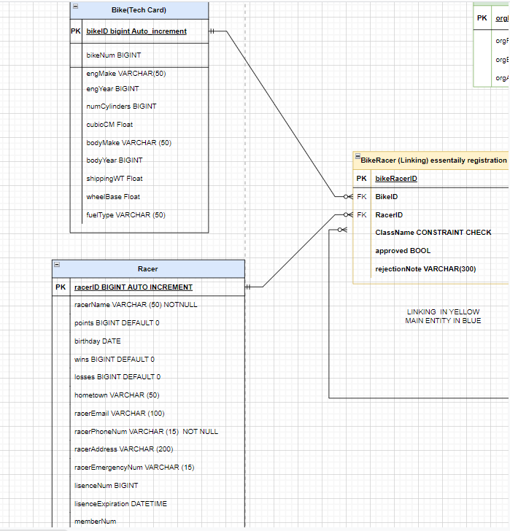
Database: Bike & Racer
Database is MySQL
BikeRacer connects Bike & Racer
Bike is our representation of a Tech Card
Racer can own many Bikes
BikeRacer displays if Tech Card is approved or rejected

Slide 5
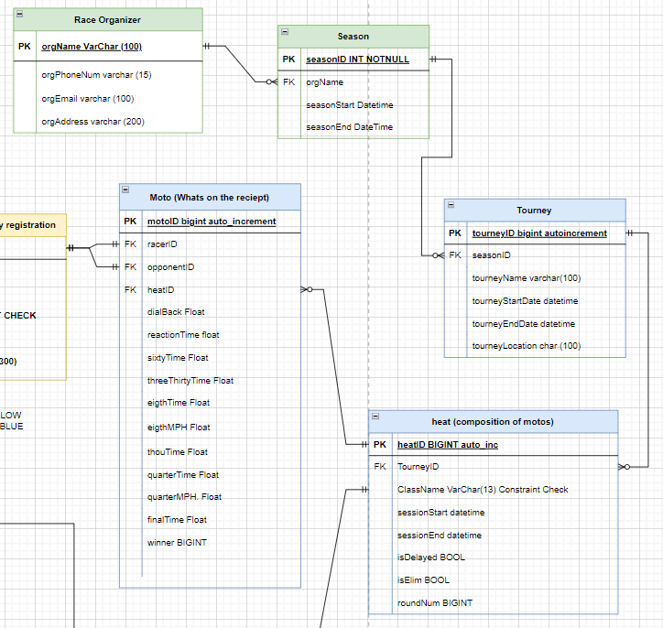
Database: Race Organizer & Season/Tournament
A race organizer makes a season
A season can contain many tournaments
A tournament contains many heats
A heat is a single round of a tournament (Round of 16, 8,...)
A heat contains many motos
Motos are races
Each racer is given a moto

Slide 6
Database: User Registration & Messages
User registration (Person)
User Email
Password
Racer ID/Organizer Name (Depending if Race Organizer or Racer)
Messages
Message ID
Title
Body
Racer ID/Tournament ID/Heat ID (Depending where the Message is sent)
Time Sent

Slide 7
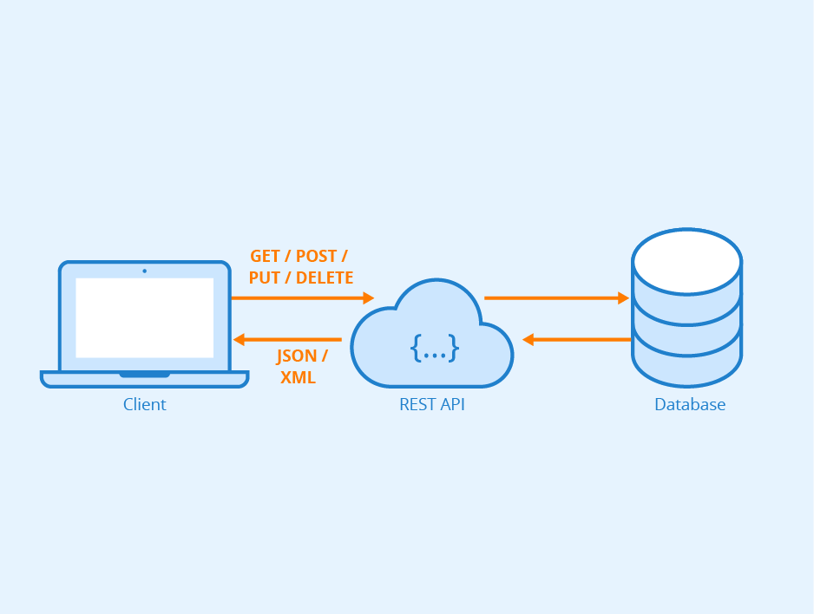
API
Allows clients to access and update the database
Provides a simple interface and controls what the client can do

Slide 8


API Tech Stack
Written in Python
Using the Flask framework

Slide 9
Requests
https://swe.cooperstandard.org/racer/1/
Base URL Endpoint
Get - Get information from API
Post - Send new information to API
Patch - Update information API already has

Slide 10
Get request
https://swe.cooperstandard.org/racer/1/
{
"racerID": 1,
"racerName": "John Doe",
"points": 10,
"birthday": "2000-01-01",
"wins": 50,
"losses": 38,
"hometown": "Denver",
"racerEmail": "email@email.com",
"racerPhoneNum": "19702340897",
"racerAddress": "123 Main St.",
"racerEmergencyNum": "12392847329"
}

Slide 11
Post request
https://swe.cooperstandard.org/tourney
{
"seasonID":1,
"tourneyName":"Example Race Event",
"tourneyStartDate":"2022-6-10",
"tourneyEndDate":"2022-6-12",
"tourneyLocation":"Denver, CO",
"classes":[
"Top Fuel",
"Grudge",
"Pro Comp",
"Pro ET"
]
}

Slide 12
Patch request
https://swe.cooperstandard.org/moto/1/
{
"reactionTime": 0.030,
"sixtyTime": 1.037,
"threeThirtyTime": 1.933,
"eigthTime": 2.837,
"eigthMPH": 158.40,
"thouTime": 3.733,
"quarterTime": 4.633,
"quarterMPH": 220.40,
"finalTime": 4.633,
"winner": true
}

Slide 13
Endpoints
All models from the database have an endpoint
Race Organizer
Season
Tournament
Heat
Moto
Racer
Bike Racer (tech cards)
Bike
User

Slide 14
Additional Racer Endpoints
https://swe.cooperstandard.org/racer/1/races?filter=past
Filter can be past, future, or next and may be omitted
Lists races a user is in, subject to the filter
https://swe.cooperstandard.org/racer/1/bikes
Lists all of a racer’s bikes
https://swe.cooperstandard.org/racer/1/bike_racers
Lists all bike_racers (tech cars) associated with a racer

Slide 15
Additional Tourney Endpoints
https://swe.cooperstandard.org/tourneys?filter=current
Filter can be current or future and may be omitted
Lists all tournaments, subject to the filter
https://swe.cooperstandard.org/tourney/1/classes
Lists all classes racing in the tourney
https://swe.cooperstandard.org/tourney/1/racers
Lists all bike racers (tech cards) in the tourney, organized by class

Slide 16
{
"Top Fuel":[
{
"bikeracerID":1,
"racerID":1,
"bikeID":1,
"className":"Top Fuel",
"roundNum":1,
"approved":true,
"rejectionNote": null
},
{
"bikeracerID":2,
"racerID":2,
"bikeID":5,
"className":"Top Fuel",
"roundNum":1,
"approved":false,
"rejectionNote":"Low tire pressure"
}
],
"Grudge":[
{
"bikeracerID":357,
"racerID":122,
"bikeID":17,
"className":"Grudge",
"roundNum":1,
"approved":true,
"rejectionNote":null
},
{
"bikeracerID":123,
"racerID":92,
"bikeID":152,
"className":"Grudge",
"roundNum":1,
"approved":true,
"rejectionNote":null
}
]
}

Slide 17


Accounts
Users can register with just a name, email, and password
Passwords are stored as Bcrypt hashes
Authenticatication uses Javascript Web Tokens (JWT)

Slide 18
Account Creation
Post request to https://swe.cooperstandard.org/register
Adds user to database and creates a racer/organizer entry
{
"email": "test@email.com",
"password": "password",
"name": "John Doe",
"accountType": "racer"
}

Slide 19
Sign in
Post request with email and password to https://swe.cooperstandard.org/login
If login is valid, API sends back an identifier and JWT
{
"racerID":1,
"access_token":"eyJ0eXAiOiJKV1QiLCJhbGciOiJIUzI1NiJ9.eyJmcmVzaCI6ZmFsc2UsImlhd
CI6MTY1NDY0ODcyNywianRpIjoiY2E4NDA3MmItYjk1Yy00NjJmLWJhNzctN2Q
1NTMwYzg0YmYxIiwidHlwZSI6ImFjY2VzcyIsInN1YiI6InRlc3RfIiwibmJmI
joxNjU0NjQ4NzI3fQ.3aNDdz9vL-sC-by9z5KMc4IUUKeaTkimkoDI79Pic7o"
}

Slide 20
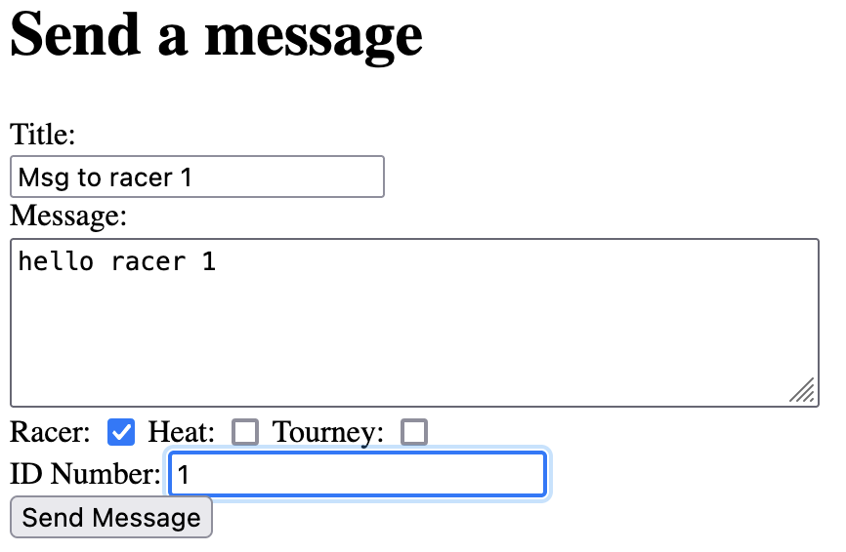
Messages
Race organizer wants to send a message
The website sends a post request to https://swe.cooperstandard.org/message/

Slide 21
Messages
Racer wants to see their messages
App makes a get request to https://swe.cooperstandard.org/message/
API sends back all messages for that racer
{
"messages":[
{
"messageID":13,
"title":"Msg to racer 1",
"body":"hello racer 1",
"timeSent":"2022-06-07 13:12:09"
},
{
"messageID":8,
"title":"Message to racers in tourney 1",
"body":"This message sent to everyone in tourney 1",
"timeSent":"2022-06-06 15:42:21"
}
]
}
API sends back all messages for that racer

Slide 22
API Next Steps
Add endpoints as needed by the front end
Improve security
Require JWT authentication for all endpoints
Ensure personal information cannot be seen by everyone

Slide 23
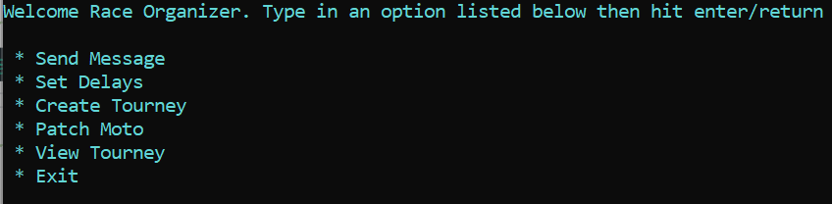
Race Organizer Interface: Overview
Command Line Interface
Loads Data from a CSV file

Slide 24
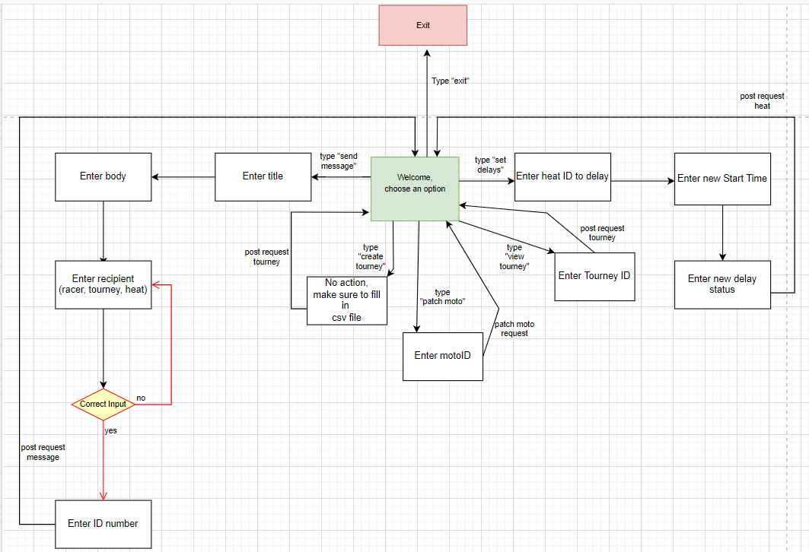
Race Organizer Interface: Layout
Send Message
Set Delays
Create Tourney
Patch Moto
View Tourney

Slide 25
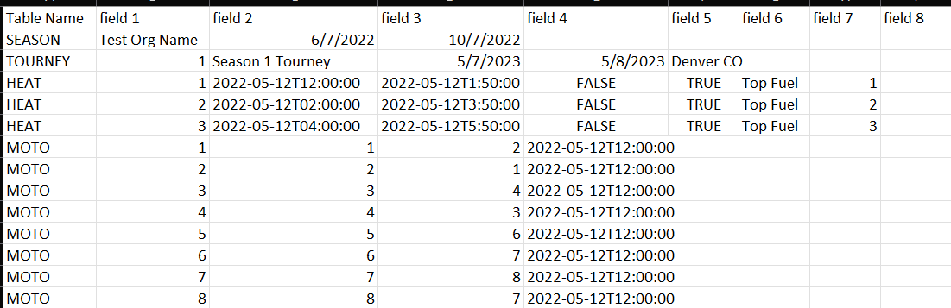
CSV: Loading a Tournament
Excel Compatible
Table Name must be in ALL CAPS

Slide 26
CSV: Patching a Moto
Same format as loading a Tournament
Table Name must be MOTO PATCH

Slide 27
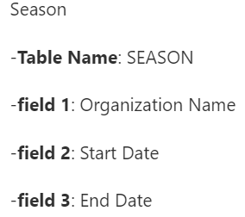
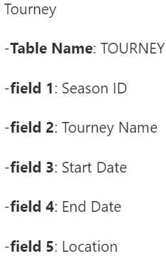
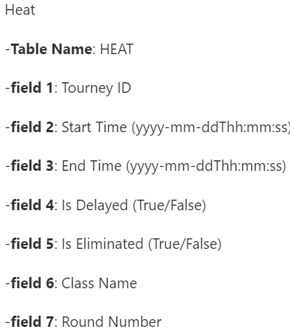
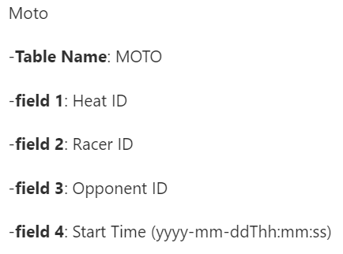
CSV: Formatting

Slide 28
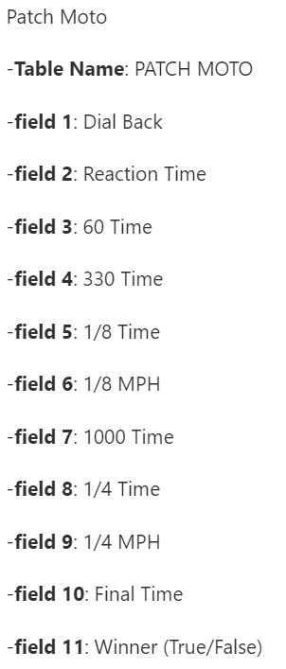
CSV: Formatting for Patch Moto

Slide 29
Race Organizer Interface Next Steps
A website interface
More functionality for editing and viewing tournaments
Bracket generation

Slide 30
App Demo
Profile
Adding a bike
Checking messages
Tech card
Tech check

Slide 31
App Furthering and Progres
Add functionality for submitting tech card
Continue functionality for Tech Card Check
Refreshing tournaments

Slide 32
How to set-up the server
Overview:
Ubuntu 20.04 LTS
Python3 and PIP
Network configuration (firewall and apache) (ports 443, 8080, 22)
Ssl certificate (we used certbot)
Sensitive config options in environment variables
Mysql version 8.0.29
Meeting recording link https://udenver.zoom.us/recording/detail?meeting_id=bAwU2MW%2BR7qd0xf4WP%2B4WQ%3D%3D

